Slide 1

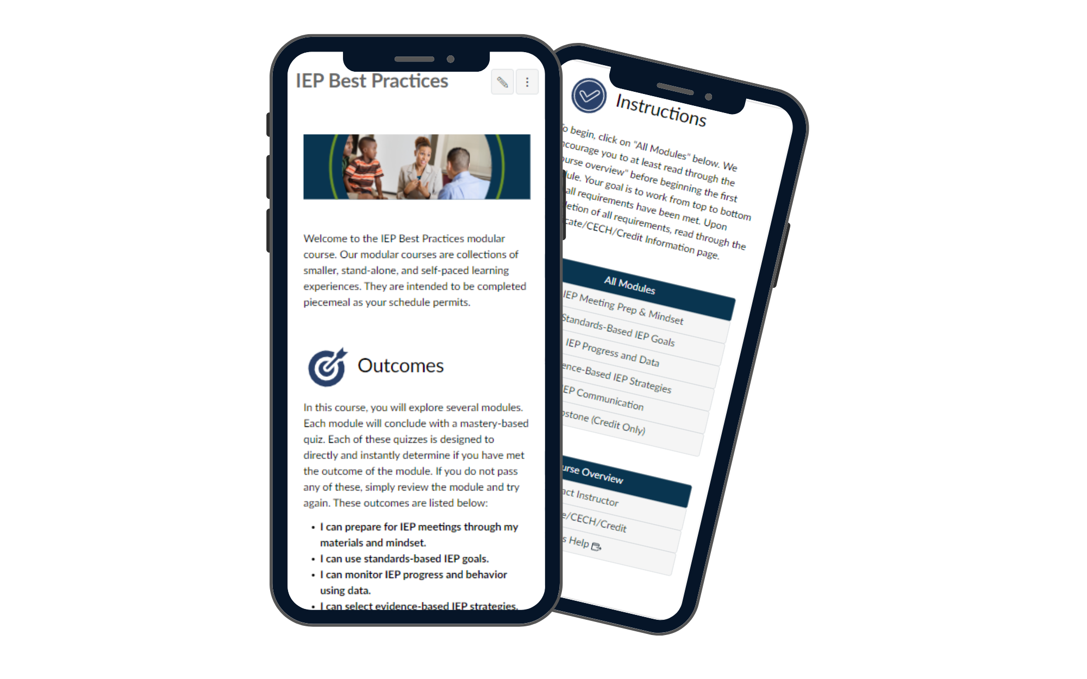
[course name]
Course Design Doc - Quick 2024 Version

Slide 2
Quick Notes: Our Roles in This Process
In developing online experiences, we each take on unique roles. In this partnership, you take on the role of a subject-matter expert (SME), and Brady takes on the role of a learning experience designer (LXD) These notes outline your partnership with Brady and how your insights will be translated into engaging digital experiences to achieve successful learning outcomes.
Learning Experience Designer (Brady)
Brady, a learning experience designer, specializes in creating engaging, accessible, and objective-aligned digital educational content and online experiences. They apply instructional design principles, adult learning theories, user interface and experience knowledge, and modern online teaching methodologies.
Subject-Matter Expert (You)
As an SME, your knowledge and practical experience ensure the learning content is accurate, relevant, and up-to-date. You'll collaborate with Brady to identify key learning points, provide real-world examples, and ensure technical soundness. As the key stakeholder, you have the final say on the finished product, which serves your needs.
Second Image by EduMe

Slide 3
Quick Notes: The Collaborative Process
Define (Brainstorm Meeting): Brady and you will brainstorm to define the project scope, target audience, learning objectives, timeline, and deliverables.
Design (Blueprint): You and Brady will independently create course blueprints, then collaborate to synthesize them into a single blueprint outlining content structure, instructional strategies, media, and technology.
Demonstrate (Test Module): Brady will build a prototype module for testing and feedback. You'll review it for accuracy and relevance, and provide content resources for test modules.
Develop: Based on feedback, you and Brady will collaboratively develop the remaining course content, sourcing additional material as needed. You'll provide subject-matter expertise and review content for accuracy.
Deliver (Exit/Offboarding Meeting): Upon completion, you'll meet to review the finished product and decide on delivery. Together with leadership, you'll establish grading criteria, communication plans, facilitator selection, and any course credits or certifications.
Tracking the Process
Feel free to email BLicht@bhssc.org if you would like information about where we are in the process. Keep in mind that priority can shift for different projects; make sure to reach out if you need to bump your project up in priority of if deadlines have changed.

Slide 4
Pre-Blueprint Brainstorming pt1 (Scope)
Background Info [What led to this discussion? What is the problem that this training will solve?] | [enter]
Rationale [How do we know that training will help? What research is there to support this claim?] | [enter]
Overall Instructional Goal(s) [What is the big goal/intention? This is stakeholder-facing as opposed to participant-facing. This is not a list of learning objectives. This should be no more than three sentences.] | [enter]
Pre-Design Course Vision [What are you currently envisioning that the course will look like? This should be no more than a single paragraph description.] | [enter]
Target Audience Characteristics [What do we know about the audience–surveys, general research, and client data?] | [enter]

Slide 5
Pre-Blueprint Brainstorming pt2 (Alignment)
Requirements & Construction [What are the resources that have to be used (if any)? Is there a cost associated with anything? How many hours/days will it take to build and deploy?] | [enter]
Alignment [Does this topic lend itself well to an existing framework such as an “Evergreen Modular Course” or “Seasonal Book Study?” Does this integrate well into other bodies of work or trainings?] | [enter]
Priority [What is the priority of this training? Why is that? How does it compare to other work? Pick two to prioritize: scale/low-facilitation, production speed, quality] | [enter]
Marketing/Sales [How will we market/sell the course? Is there competition for such a course?] | [enter]
Other [Is there anything else that should be considered at this time?] | [enter]

Slide 6

Pre-Blueprint Brainstorming pt3 (Other Continued)

Slide 7
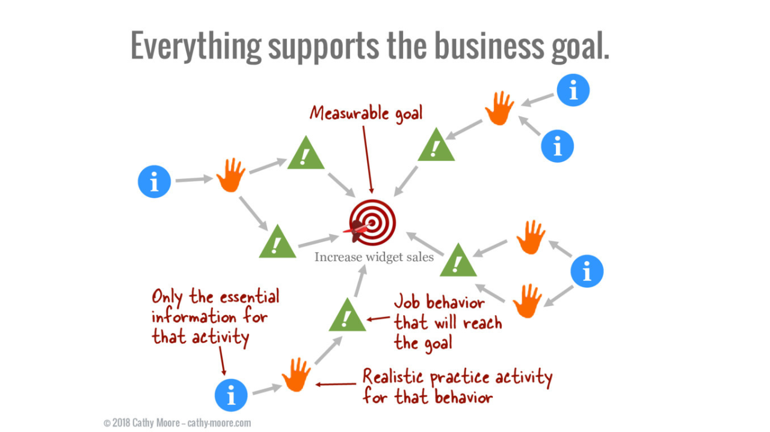
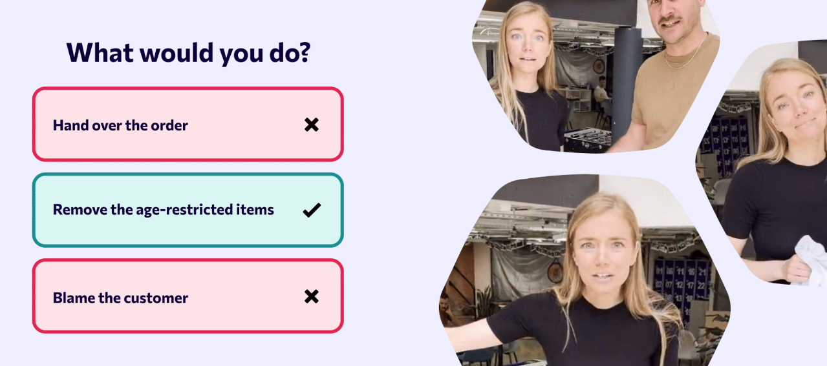
Quick Notes: SBL, Action Mapping, and Facilitation
We apply action mapping (like backward design) for course design, emphasizing behavioral change and strategic practice & content.
We use automated assessments (MCQs, test banks) to reduce facilitation time and enhance feedback speed, ensuring realism through Scenario-Based Learning (SBL).
Second Image by EduMe

Slide 8
Draft of Goals
Overall Topic:
Overall Goal:
Sub-Topic:
Sub-Topic:
Sub-Topic:
Sub-Topic:
Sub-Topic:
Outcome:
Outcome:
Outcome:
Outcome:
Outcome:
Module 1 Design
Module 2 Design
Module 3 Design
Module 4 Design
Module 5 Design

Slide 9
Draft of Potential Strategies
View All Hattie Strategies →
Strategy | Why? | How it will look.

Slide 10
Module 1 Design
← Back to Overall Design
Type (Page, Assignment, Quiz,...) | Description & Look/Feel | Success Criteria | Activity/Practice | Readings/Videos/Content
Overview
Page
Page
Page
Assignment
Quiz

Slide 11
Module 2 Design
← Back to Overall Design
Type (Page, Assignment, Quiz,...) | Description & Look/Feel | Success Criteria | Activity/Practice | Readings/Videos/Content
Overview
Page
Page
Page
Assignment
Quiz

Slide 12
Module 3 Design
← Back to Overall Design
Type (Page, Assignment, Quiz,...) | Description & Look/Feel | Success Criteria | Activity/Practice | Readings/Videos/Content
Overview
Page
Page
Page
Assignment
Quiz

Slide 13
Module 4 Design
← Back to Overall Design
Type (Page, Assignment, Quiz,...) | Description & Look/Feel | Success Criteria | Activity/Practice | Readings/Videos/Content
Overview
Page
Page
Page
Assignment
Quiz

Slide 14
Module 5 Design
← Back to Overall Design
Type (Page, Assignment, Quiz,...) | Description & Look/Feel | Success Criteria | Activity/Practice | Readings/Videos/Content
Overview
Page
Page
Page
Assignment
Quiz

Slide 15
Look & Feel

Slide 16
List of Strategies with Hattie Effect Size
← Back to Strategies
 | Strategy (Click here for strategy definitions) | Effect Size
 | Jigsaw Method | 1.2
 | (Teacher) Credibility | 1.09
 | Integrate Knowledge | 0.93
 | Success Criteria | 0.88
 | Video Review | 0.88
 | (Teacher) Clarity | 0.84
 | Classroom Discussion | 0.82
 | Mnemonics | 0.8
 | Deliberate Practice | 0.79
 | Planning & Prediction | 0.76
 | Reflection | 0.75
 | Help Seeking | 0.72
 | Summarizing | 0.71
 | Self-Directed Learning | 0.67
 | Spaced Practice | 0.65
 | Concept Mapping | 0.64
 | Vocabulary | 0.63
 | Feedback | 0.62
 | Metacognition | 0.6
 | Direct Instruction | 0.59
 | Interactive Video | 0.58
 | Group Cohesion | 0.53
 | Clear Goal Intentions | 0.51
 | Imagery | 0.51
 | Note-taking | 0.51
 | Peer Tutoring | 0.51
 | Questioning | 0.49
 | Small Group Learning | 0.47
 | Differentiation | 0.46
 | Practice Testing | 0.46
 | Interleaved Practice | 0.44
 | Peer Assessment | 0.44
 | Underlining | 0.44
 | Advance Organizers | 0.42
 | Virtual Reality | 0.42
 | Gaming / simulations | 0.41
 | Goal Commitment | 0.4
 | Collaborative Learning | 0.39
 | Worked Examples | 0.37
 | Audiovisuals | 0.36
 | Tactile Stimulation | 0.36

Slide 17
Draft of Final Assessment (if needed)
Some institutions may call for a written assessment or project to provide credit. Given the time required to score and provide feedback on these, these should only be implemented if required. Otherwise, the assessments for courses should be set up as an automatically-graded quiz per module.
If there needs to be a final assessment, describe it here:

